Slide 1


Crime hotspot detection
Presented by,
Md Minhajul Karim
1903710201864
SUSPECT: TIMMY JIMMY

Slide 2
TABLE OF CONTENTS
04
01
05
02
03
Methodology
Introduction
Outcomes
Problem STATEMENT
06
Conclusions
Key Objectives
07
Future Scopes

Slide 3

INTRODUCTION
Crime hotspot detection refers to the identification of areas or locations where criminal activity is more frequent or concentrated. This project aims to leverage machine learning algorithms to identify areas where crime is more likely to occur. By providing law enforcement agencies with real-time insights into crime patterns and trends, the project seeks to enhance their ability to prevent crime and promote public safety.

Slide 4


02
PRoblem STATEMENT

Slide 5
Problem STATEMENT
To facilitate effective distribution of police forces in a city among multiple districts based on the extent to which each district is prone to crime at a given hour, in a given day, for a given month.

Slide 6


03
Key objectives
SUSPECT: JENNA DOE

Slide 7
key OBJECTIVES
Crime prevention
Efficient use of resources
Faster response times
To reduce crime by targeting high-risk regions with resources.
To apply AI in crime hotspot detection to help law enforcement focus on high-crime areas.
To improve response times by utilizing AI to detect suspected illegal activities in real time and alert law enforcement, preventing crimes or catching perpetrators.

Slide 8
MOST FAMOUS MURDER CASE Locations
MURDER LOCATION 1
MURDER LOCATION 2
MURDER LOCATION 3
MURDER LOCATION 4

Slide 9
METHODOLOGY
Obtain
Scrub
City of Chicago Data Portal Training Sample : Data from 2015 - 2019 (May) Test Sample : Data from 2012 – 2014 Over 11 lakh entries
Removing Missing Values: 98.55% entries retained Feature Engineering: Decomposing "Date" feature Data Aggregation: Grouping Data to count crimes per time point
Model
Explore
Supervised Classification Problem Imbalanced Dataset [28:51:21 ratio] 3 Samples used 7 ML algorithms tested Gradient Boosting Tree worked best
Create a "Target" feature Label based on "Normal distribution" and Intuition

Slide 10
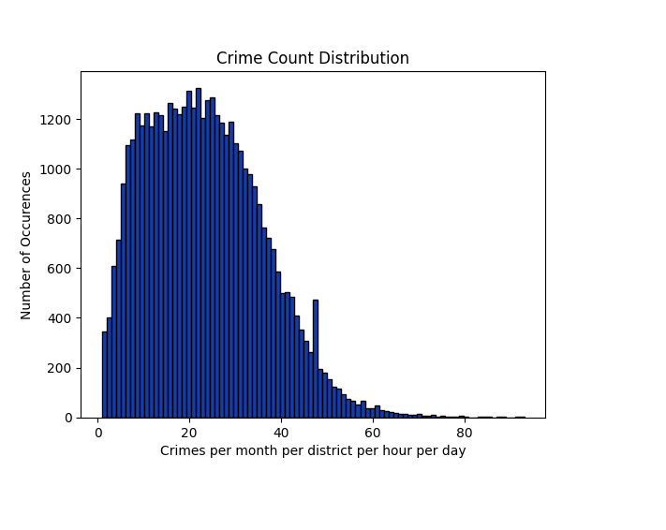
Explore data

Slide 11
outcomes
Successful development and deployment of an AI system for crime hotspot detection.
Improved accuracy and efficiency of crime hotspot detection, resulting in better resource allocation and faster response times.
Development and Implementation
Continued improvement of the AI system's accuracy and efficiency through regular evaluations and updates.
Improved decision-making by law enforcement agencies through data-driven insights provided by the AI system.
Evaluation and Improvement

Slide 12
CONCLUSIONS
Based on the accuracy rate of 78.35181678838698, it can be concluded that the "crime hotspot detection" AI project has achieved a relatively high level of accuracy in identifying potential crime hotspots. Still, more work may be needed before it can be used effectively in the actual world.

Slide 13

Future Scopes
Integration with other technologies.
Predictive analytics.
Increased scalability.
Explainability and transparency

